Slide 1
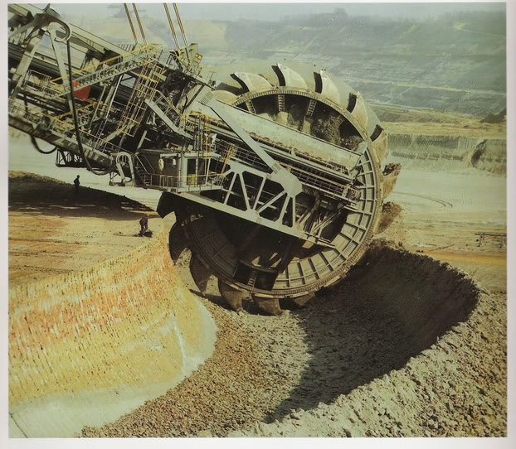
Demystifying Big Data
Jonathan Mills

Slide 2
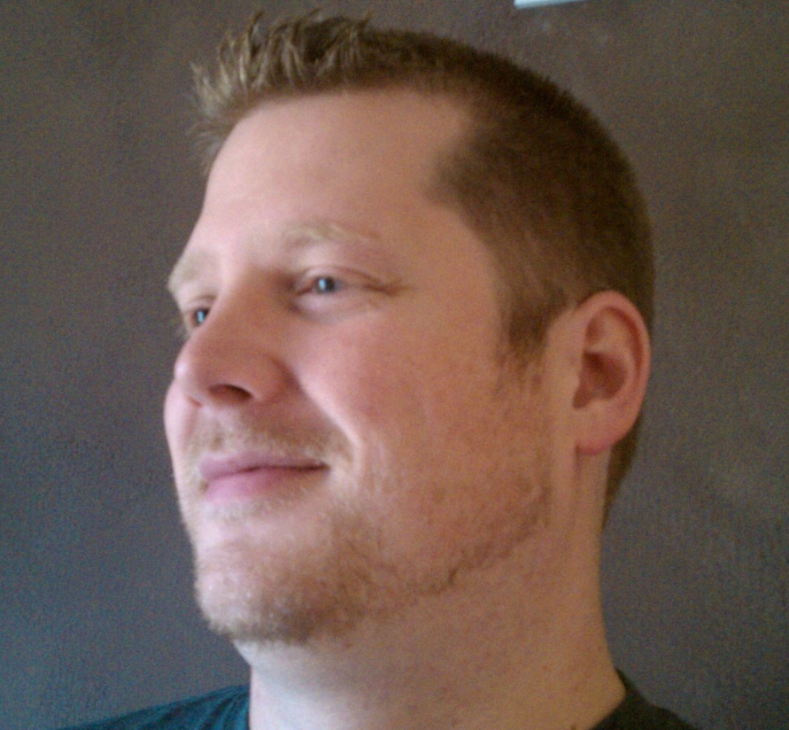
Who Is This Guy?
Director R&D @ Paige Technologies
@jonathanfmills
Jonathanfmills.com
Notes:
A little about me
As a manager, I should not have to supervise the work of others……
As a manager, I am responsible for making the team the most efficient team they can be
Over the long term… Sticks don’t work over long term
Make sure they want to come to work every morning
Make sure they feel appreciated.

Slide 3
Big data is like teenage sex: everyone talks about it, nobody really knows how to do it,
everyone thinks everyone else is doing it, so everyone claims they are doing it...

Slide 4
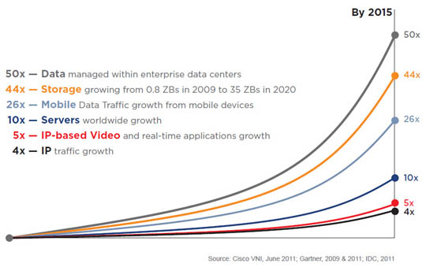
Why Big Data?
Notes:
Its not just that the data is there, you want to be able to DO something with it.

Slide 5



Slide 6
Slq Server can handle databases over 3 PB

Slide 7


Slide 8
Big Table
DynamoDB

Slide 9

What Is Big Data?

Slide 10
V
V
V

Slide 11
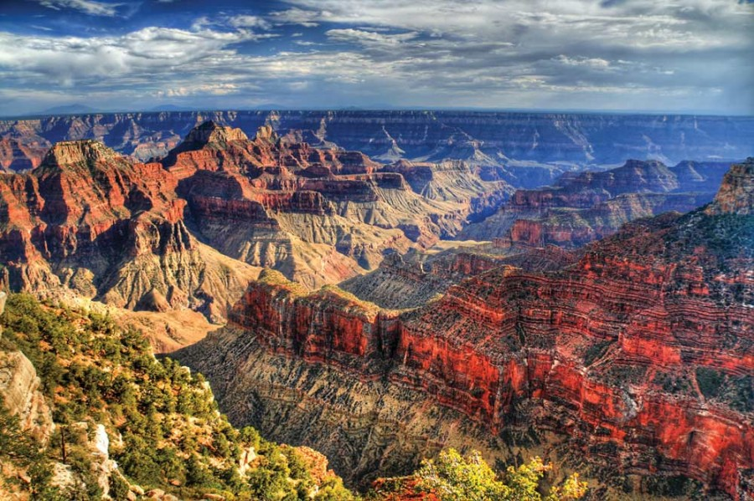
Volume
….

Slide 12
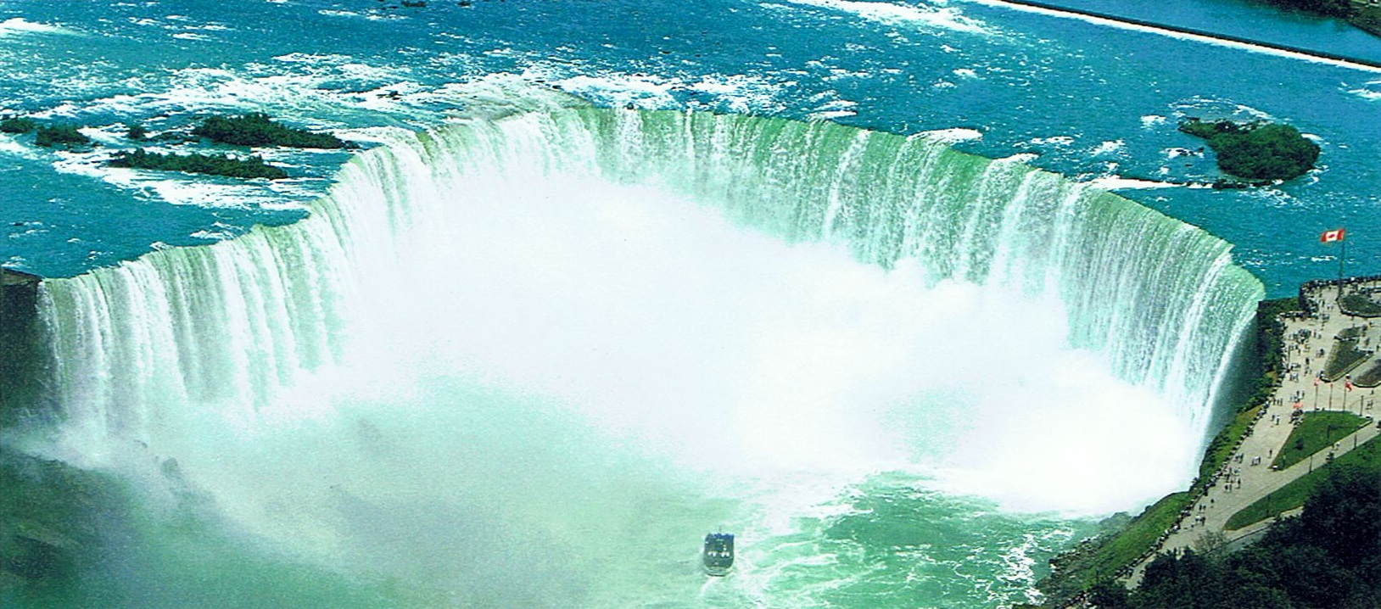
Velocity
Notes:
Velocity
Data Flow
Internet of things…
Streaming Data
Twitter – tweets per minute
Cerner for sepsis

Slide 13
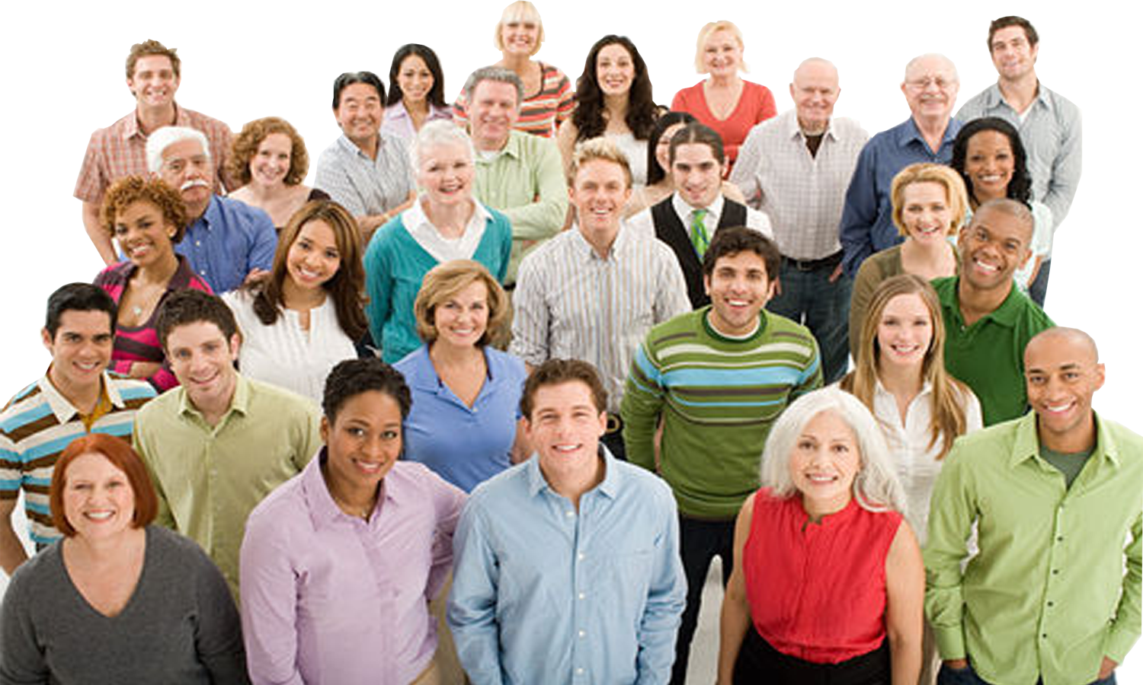
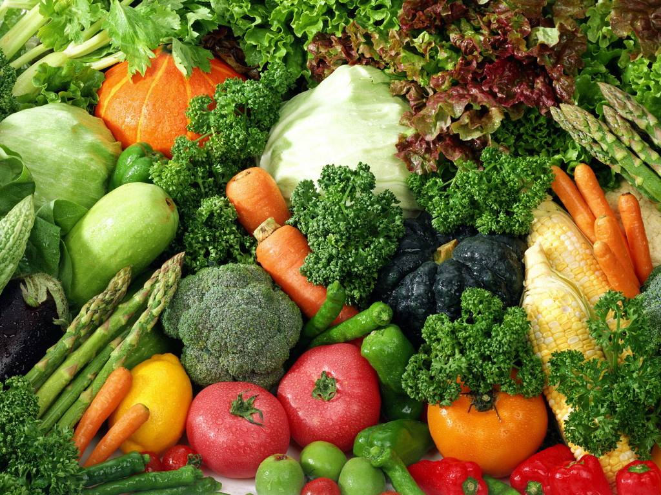
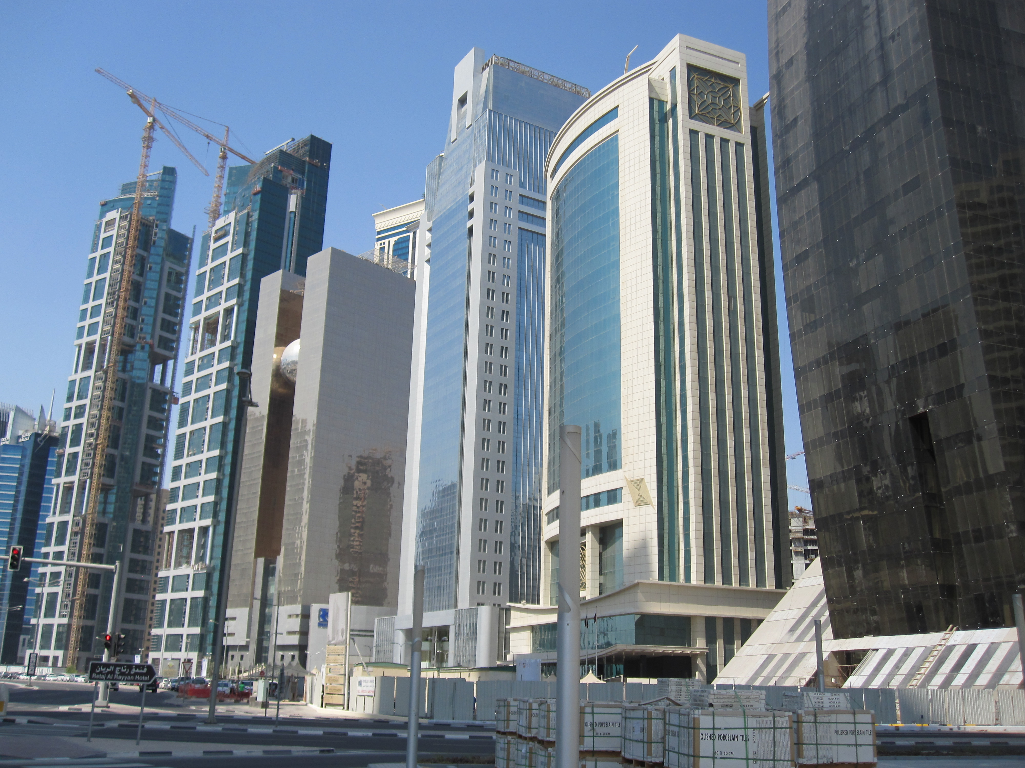
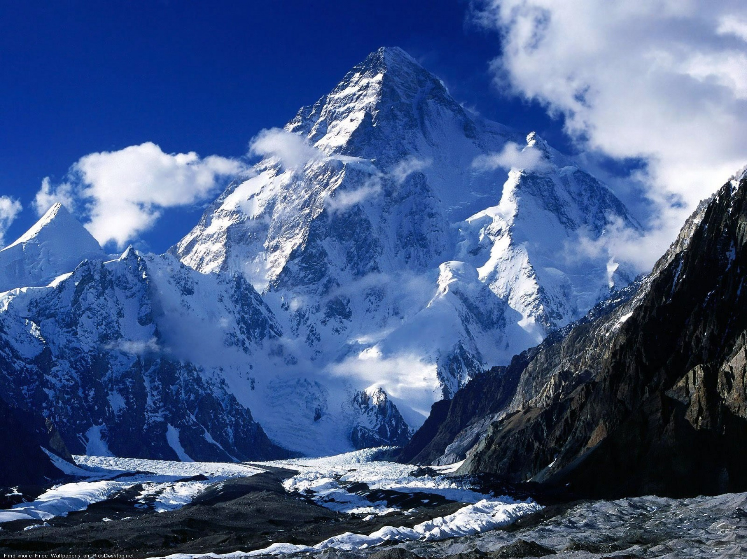
Variety
Notes:
Documents, Finances, Personal Files…
But now add photos, AV, 3d Models, Location Data
Can’t categorize -- unstructured

Slide 14
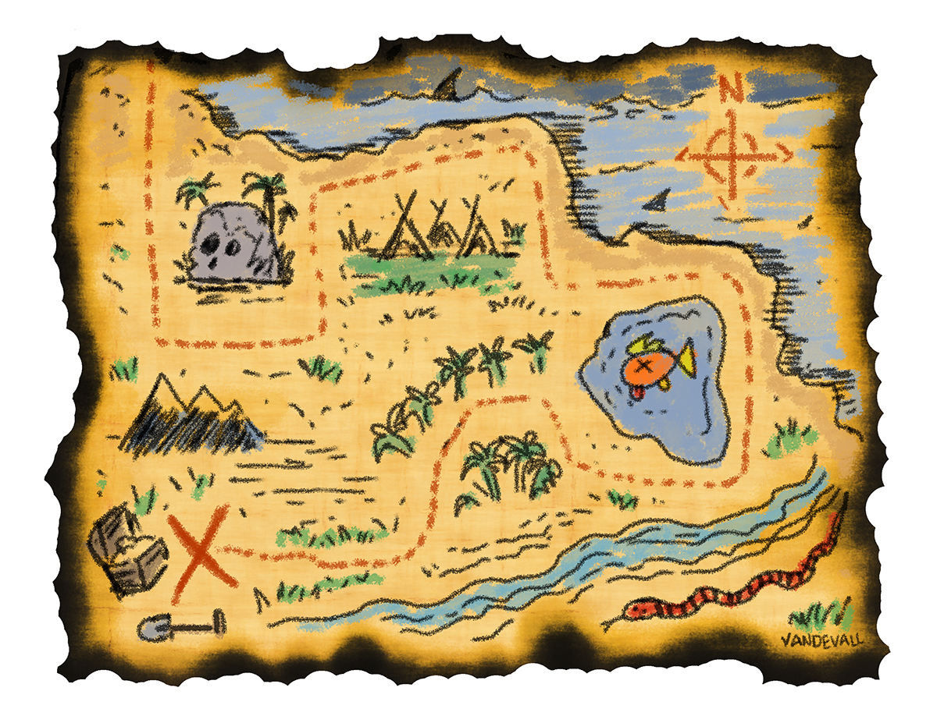
Map Reduce
Notes:
Google Developed
Hadoop is the open source version of MapReduce
Map Step
Split the Data and PreProcess
Reduce Step
Aggregate the results

Slide 15
Map Reduce?

Slide 16

Notes:
What is Hadoop?
Doug Cutting Nutch spider scrawler….
Open Source Version of Google’s Map reduce plus HDFS File system for managing the data.
3 Copies of everything.
All these servers have disk and CPU. So instead of pulling the data to the code, you push the code to the data

Slide 17


Notes:
Cloudera, Doug Cutting Co-Creator of Hadoop is the – Architect at Cloudera. He pulled some people with him.
The Original team was at Yahoo and they where spun off into Hortonworks

Slide 18
But it doesn’t end there….

Slide 19
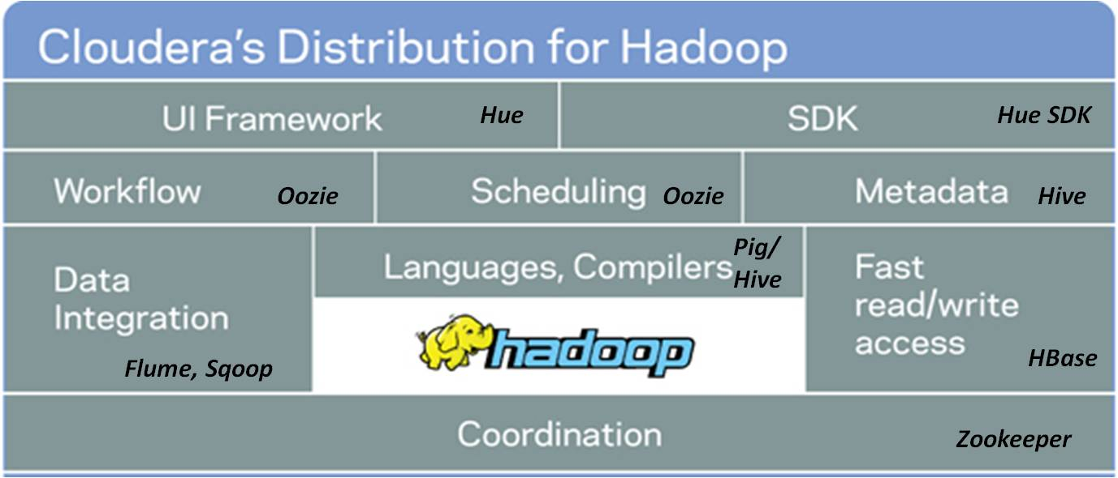

Slide 20
Hadoop vs NoSql
Notes:
Hadoop does data aggregation, nosql is for simple selects….

Slide 21
Why is it called NoSql?
Notes:
Johan Oskarsson in 2009 organizing an event

Slide 22
#

Slide 23
NoSql Characteristics
Non-Relational
Open-Source
Cluster Friendly
21st Century
Schema-less

Slide 25

Key/Value Store
MongoDB
Scalability
RDBMS
Functionality
Notes:
Vs RDBMS
Scaling Horizontally vs Vertically
RDBMS == High Functionality & Low Scalability | MongoDB == High Scalability & Moderate => High Functionality
Mongo Gives Up Joins & Transactions, because those are the two main things that scale poorly horizontally
No Constraints
No Schema
16mb document size limit.

Slide 26










Slide 27
Document
Column
Family
Graph
Key Value
Notes:
HBAse is BIG Table

Slide 28
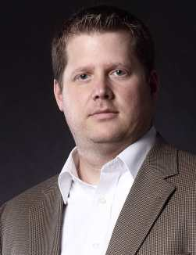
Key-Value
Jmills37
Information….
Password, Preferences, etc…..

Slide 29
Column Family
Jmills37
Jmills37
Security
Preferences
Password: sfjs;ofjsdo;jf
Last Login: 1/27/14
Trusted Devices: XXXXX
Screen Orientation: L
Favorite Stories: adsodkfjsdot
Contact Preference: Push
Notes:
Keep like items on the same instance

Slide 30

Document

Slide 31
Document

Slide 32
Document
{
"_id": {
"$oid": "515d9885e4b035b7009ddc1c"
},
"id": 9948,
"name": "Managing Developers",
"level": 100,
"length": "1 Hour",
"synopsis": “",
"room": 2207,
"slot": "Saturday 9:40",
"speakerName": "Jonathan Mills",
"speakerId": 9912
}
Notes:
Refferential Integrity
No Schema / Implied Schema

Slide 33
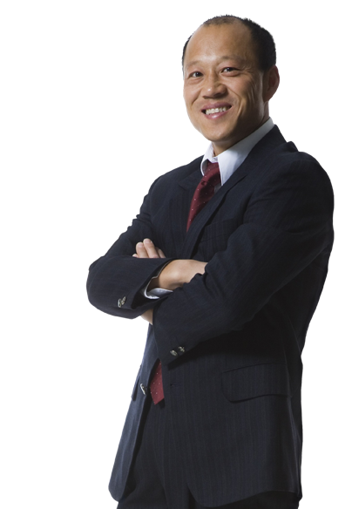
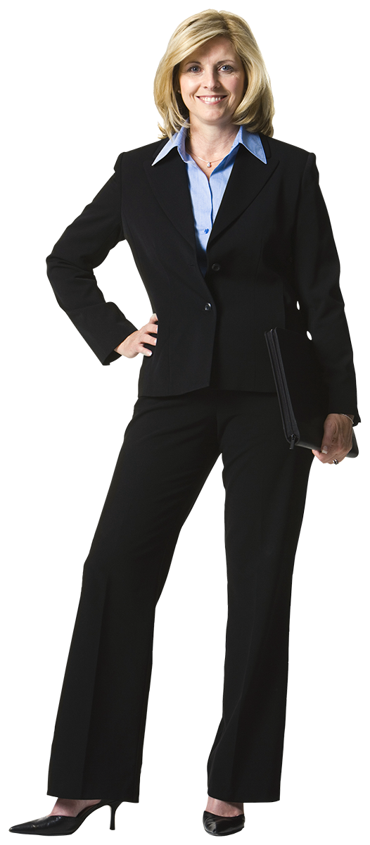


Graph DBS
Worked With
Dave
Works With
Susan
Works With
Tracy
Mark

Slide 34
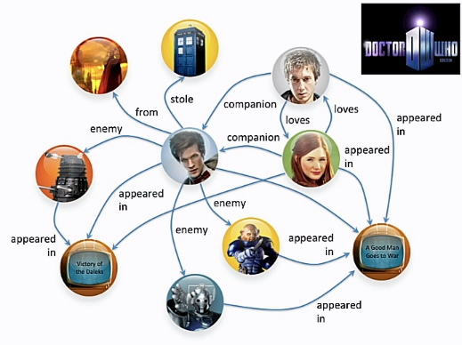
Graph DBS

Slide 35
Document
Column
Family
Graph
Key Value

Slide 36
Document
Column
Family
Graph
Key Value

Slide 37
Document
Column
Family
Graph
Key Value

Slide 38


Why Would I Do This?
Customer Insight

Slide 39
What Is The Next Netflix Series?
Political Dramas
British Shows
Kevin Spacey
David Fincher
Notes:
David Fincher – Alien3, Seven, The Girl With The Dragon Tattoo, Zodiac, The Game….

Slide 40
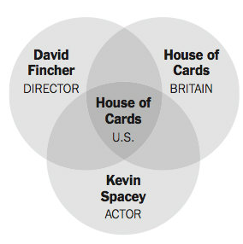
House Of Cards?

Slide 41
Why Would I Do This?
Customer Insight
Forecasting trends

Slide 42
Why Would I Do This?
Customer Insight
Forecasting trends
Healthcare trends

Slide 43
Why Would I Do This?
Customer Insight
Forecasting trends
Healthcare trends
Closer To Home….

Slide 44
Why Should I Care?
Evade The Hype…..

Slide 45
Don’t start with the data….
Start with a need… use data as a solution.

Slide 46
Why Should I Care?
Is your data really big?
Does the insight your data could provide really matter?
Are you ready for the volume you will get if you collect it?

Slide 47
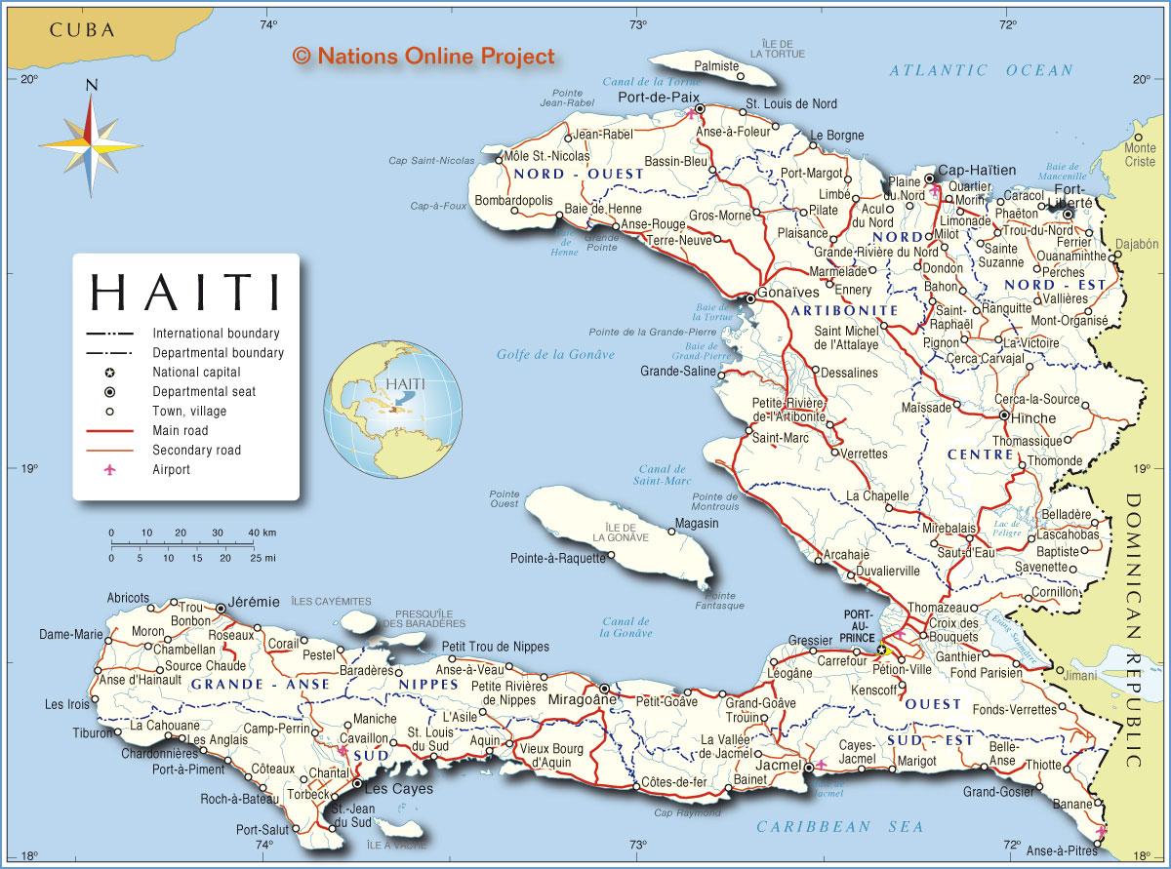
Be a Skeptic

Slide 48
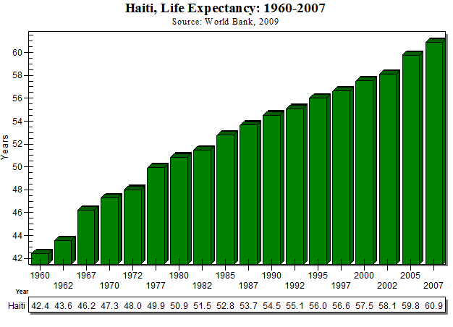
Notes:
The data was not flawed. The assumptions based on the data was bad.

Slide 49
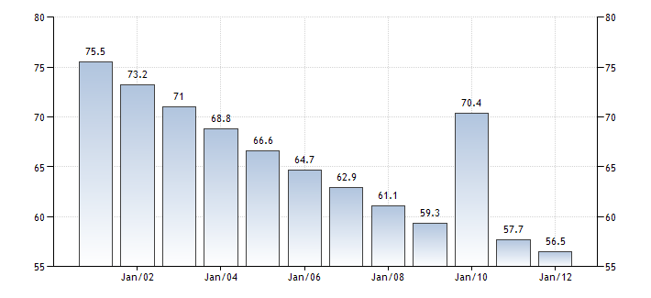

Slide 50
Notes:
The data was not flawed. The assumptions based on the data was bad.

Slide 51
Questions?

Slide 52
Who Is This Guy?
Research and Development \
Paige Technologies
@jonathanfmills
Jonathanfmills.com
Notes:
A little about me
As a manager, I should not have to supervise the work of others……
As a manager, I am responsible for making the team the most efficient team they can be
Over the long term… Sticks don’t work over long term
Make sure they want to come to work every morning
Make sure they feel appreciated.

